Slide 1
Chapter 12 International Trade Theory and Development Strategy
Todaro and Smith (2015)

Slide 2
International Trade: Some Key Issues
Many developing countries rely heavily on exports of primary products with attendant risks and uncertainty
Many developing countries also rely heavily on imports (typically of machinery, capital goods, intermediate producer goods, and consumer products)
Many developing countries have chronic deficits on current and capital accounts which depletes their reserves, causes currency instability, and may slow economic growth
Recently many developing countries sought to promote exports and accumulate large foreign exchange reserves to cushion against crises - spurring new policy debates

Slide 3
International Trade: Some Key Issues
Five Basic Questions about Trade and Development
How does international trade affect economic growth?
How does trade alter the distribution of income?
How can trade promote development?
Can developing countries determine how much they trade?
Is an outward-looking or an inward-looking trade policy best?

Slide 4
International Trade: Some Key Issues
The Importance of Exports to Different Developing Nations
Importance of exports to developing nations
Exports of developing countries are generally less diversified than those of developed countries
Merchandise exports as a share of GDP are often higher for developing countries

Slide 5
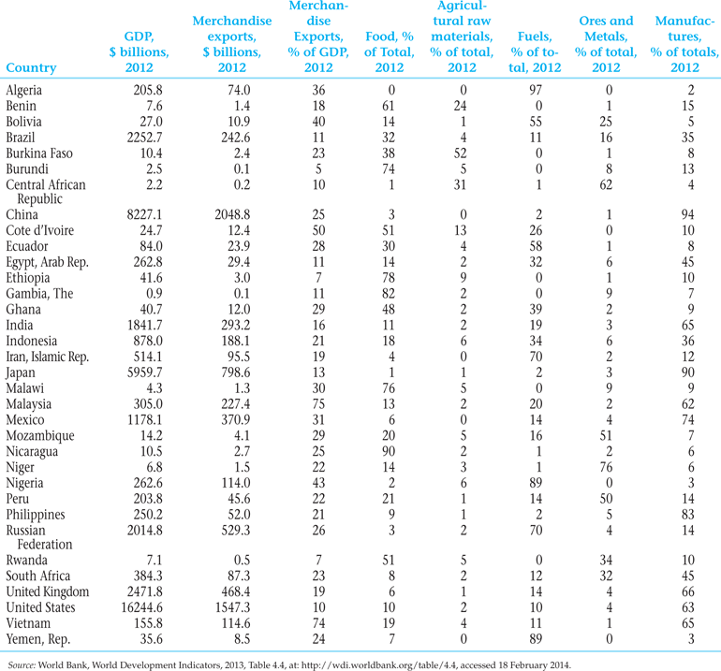
Table 12.1 Structure of merchandise exports: Selected Countries, 2012

Slide 6
Demand Elasticities and Export Earning Instability
Often low price elasticity of demand for agricultural commodities but supply shocks
Often low price elasticity of supply for basic commodities but demand shocks
Result can be export earnings instability; risks to income
Also, low income elasticity of demand for primary products:

Slide 7
The Terms of Trade and the Prebisch-Singer Hypothesis
Total export earnings depend upon:
Total volume of exports sold; and,
Price paid for exports
Prebisch and Singer argued commodity export prices fall over time, so developing countries lose revenue unless they can continually increase export volumes
They concluded that developing countries need to avoid dependence on primary exports
Some recent evidence is reported in Box 12.1

Slide 8
12.3 The Traditional Theory of International Trade
Comparative advantage
specialization
Relative factor endowments and international specialization: the Neoclassical model
Heckscher and Ohlin (factor endowment theory)
Different products require productive factors in different ratios
Countries have different endowments of factors of production

Slide 9
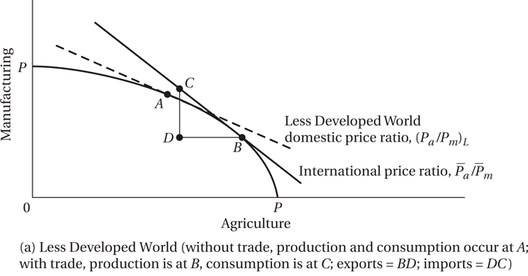
Trade with Variable Factor Proportions and Different Factor Endowments

Slide 10
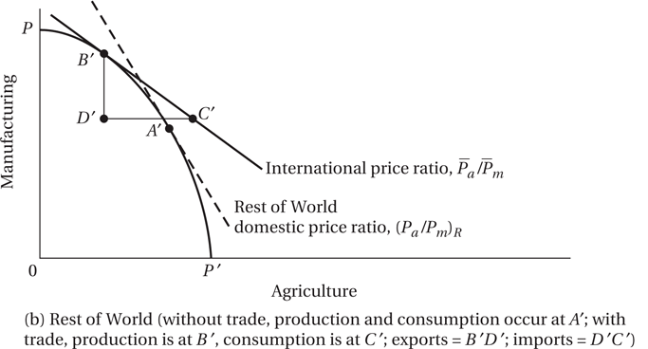
Trade with Variable Factor Proportions and Different Factor Endowments (continued)

Slide 11
The Traditional Theory of International Trade (cont’d)
Main conclusion of the neoclassical model is that all countries gain from trade
World output increases with trade
Countries will tend to specialize in products that use their abundant resources intensively
International wage rates and capital costs will gradually tend toward equalization
Returns to owners of abundant resources will rise relatively
Trade will stimulate economic growth

Slide 12
12.3 The Traditional Theory of International Trade
Trade theory and Development: The Traditional Arguments
Trade stimulates economic growth
Trade promotes international and domestic equality
Trade promotes and rewards sectors of comparative advantage
International prices and costs of production determine trading volumes
Outward-looking international policy is superior to isolation

Slide 13
The Critique of Traditional Free-Trade Theory, in the Context of Developing-Country Experience
The following assumptions of the basic Neoclassical model have been scrutinized:
Fixed resources, full employment, international factor immobility
And fixed, freely available technology and consumer sovereignty vs. product cycle, ongoing development of synthetic substitutes for developing countries exports, and opportunities for dynamic gains in leading sectors
Internal factor mobility vs. different types of structural rigidities; and perfect competition vs. pervasive market power
Governmental non-interference in trade vs. active trade policies
Balanced trade and international price adjustments vs. instability
Trade gains accruing to nationals vs. export enclaves with foreign ownership; distinction between GDP and GNI becomes important

Slide 14
The Critique of Traditional Free-Trade Theory, in the Context of Developing-Country Experience
Fixed Resources, Full Employment, and the International Immobility of Capital and Skilled Labor
– Traditional trade theory applies only to basic factors (unskilled labor, physical resources)
– But creation of advanced factors (knowledge resources, specialized infrastructure) is the first priority
–

Slide 15
The Critique of Traditional Free-Trade Theory, in the Context of Developing-Country Experience
Alternative Theories
Vent for Surplus theory
Vent for surplus is a theory that was formulated by Adam Smith and later revised by Hla Myint on his thesis of South East Asia. The theory states that when a country produces more than it can consume, it produces a surplus. This underutilization causes an inward movement on the production possibilities frontier.

Slide 16
The Critique of Traditional Free-Trade Theory, in the Context of Developing-Country Experience
Fixed, Freely Available Technology and Consumer Sovereignty
Challenged by the Product Cycle theory
Development of synthetic substitutes for developing country exports

Slide 17
The Critique of Traditional Free-Trade Theory, in the Context of Developing-Country Experience
International Factor Mobility, Perfect Competition, and Uncertainty: Increasing Returns, Imperfect Competition, and Issues in Specialization
Structural realities in developing countries
Increasing returns and exercise of monopolistic control over world markets
Risk and uncertainty inherent in international trading arrangements

Slide 18
The Critique of Traditional Free-Trade Theory, in the Context of Developing-Country Experience
The Absence of National Governments in Trading Relations
Industrial policy is crafted by governments
Commercial policies instruments (tariffs, quotas) are state constructs
International policies can result in uneven distribution of gains from trade

Slide 19
The Critique of Traditional Free-Trade Theory, in the Context of Developing-Country Experience
Balanced Trade and International Price Adjustments
Unrealistic (example: impact of oil price hikes of the 1970s)
Trade gains accruing to nationals
Enclave economies are promoted by trade
Difference between GDP and GNI becomes important

Slide 20
Conclusions on Trade Theory and Economic Development Strategy
Some Conclusions on Trade Theory and Economic Development Strategy
Trade can lead to rapid economic growth under some circumstances
Trade seems to reinforce existing income inequalities
Trade can benefit developing countries if they can extract trade concessions from developed countries
Developing countries generally must trade
Regional cooperation may help developing countries

Slide 21
Traditional Trade Strategies and Policy Mechanisms for Development: Export Promotion versus Import Substitution
Export promotion: looking outward and seeing trade barriers
Primary-commodity export expansion, limited demand
Low income elasticities
Low population growth rates in developing economies
Decline in prices implies low revenue (some periods of price spikes, including recent years, but very long-run trend has been downward)
Lack of success with international commodity agreements
Development of synthetic substitutes
Agricultural subsidies
Primary-commodity export expansion, supply rigidities
Expanding Exports of manufactured goods: Greater successes, particularly China; unevenly distributed across the developing world

Slide 22
Traditional Trade Strategies and Policy Mechanisms for Development: Export Promotion versus Import Substitution
Import substitution: looking inward but still paying outward
Tariffs, infant industries, and the theory of protection

Slide 23
Traditional Trade Strategies and Policy Mechanisms for Development: Export Promotion versus Import Substitution
The import substitution (IS) industrialization strategy and results
Protected industries get inefficient and costly
Foreign firms often benefit more
Subsidization of imports of capital goods tilts pattern of industrialization and contributes to balance of payments (BOP) problems
Overvalued exchange rates hurt exports
Does not stimulate self-reliant integrated industrialization

Slide 24
Traditional Trade Strategies and Policy Mechanisms for Development: Export Promotion versus Import Substitution
Tariff Structure and Effective Protection
Nominal rate of protection
Effective rate of protection

Slide 25
The nominal tariff rate
The nominal tariff rate, t, is
(12.1)
Where
p′ is the tariff-inclusive price
p is the free trade price

Slide 26
Tariff Structures and Effective Protection
Tariff Structures and Effective Protection
The effective tariff rate is
(12.2)
Where
v′ is the value added per unit of output,
inclusive of the tariff
v is the value added per unit of output
under free trade

Slide 27
Standard argument for tariff protection
Standard argument for tariff protection
Sources of revenue
Response to chronic BOP problems
Help foster industrial self-reliance (general IS)
Greater control over economic destinies
Must be applied selectively and wisely
Infant industry protection argument
Many examples of perceived failures, but some success in East Asia

Slide 28
Traditional Trade Strategies and Policy Mechanisms for Development: Export Promotion versus Import Substitution
Foreign-exchange rates, exchange controls, and the devaluation decision
Developing country currencies have often been overvalued (excess of local demand over available exchange)
A developing country can devalue currency, or
Can run down reserves
Can limit excess demand through taxes, tariffs, dual exchange rates
Can use exchange controls
Can switch to freely convertible foreign exchange

Slide 29
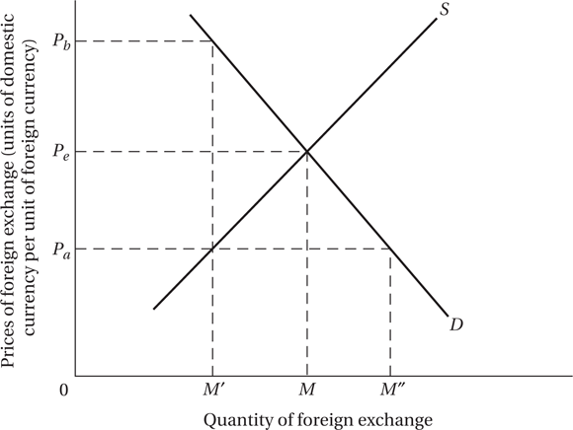
Figure 12.4 Free-Market and Controlled Rates of Foreign Exchange

Slide 30
Foreign-exchange rates, exchange controls, and the devaluation decision
Chronic payments deficits can be amended by a currency devaluation
Difference between depreciation and devaluation
Higher import prices result in an inflationary wage-price spiral
Distributional effects

Slide 31
Trade Optimists and Trade Pessimists: Summarizing the Traditional Debate
Trade Optimists and Trade Pessimists: Summarizing the Traditional Debate
Trade pessimist arguments
Limited growth of world demand for primary exports
Secular deterioration in terms of trade
Specializing in comparative advantage inhibits industrialization, skills accumulation, and entrepreneurship
Rise of “new protectionism”; WTO benefits limited in practice

Slide 32
Trade optimist arguments - trade liberalization
Trade optimist arguments - trade liberalization:
Promotes competition and efficiency
Generates pressure for product improvement
Accelerates overall growth
Attracts foreign capital and expertise, which are in scarce supply in most developing countries
Generates foreign exchange to use for food imports if agricultural sector lags behind or suffers natural catastrophes
Eliminates distortions caused by government interventions including corruption and rent-seeking activities
Promotes equal access to scarce resources,
Enables developing countries to take full advantage of reforms under the WTO

Slide 33
Export-Oriented Industrialization Strategy: Some arguments in the literature on why, in principle, it could be effective
There are market failures in transfer of innovations
Coordination failures may make industrialization problematic
Export expansion may facilitate technology transfer through contacts with foreign firms, industry spillovers, scale economies
There may be learning by doing (or “watching”) effects in manufacturing sectors
Export targets more visible; focus on manageable problems
Thus, export oriented industrial policy may help overcome market failures in the process of technological progress

Slide 34
The Industrialization Strategy Approach to Export Policy
Focus on government interventions to encourage exports, especially those with higher skill and technology content (industrial policy)
Problem: without proper attention to incentives, industrial policies may be counterproductive too
WTO rules and industrial policies – gray areas remain

Slide 35
Economic Integration: Theory and Practice
Economic Integration: Theory and Practice
The growth of trade among developing countries.
Integration encourages rational division of labor among a group of countries and increases market size
Provides opportunities for a coordinated industrial strategy to exploit economies of scale
Trade creation
Trade diversion

Slide 36
Trade Policies of Developed Countries: The Need for Reform and Resistance to New Protectionist Pressures
Rich-nation economic and commercial policies matter for developing countries
Tariff and non-tariff barriers to developing country exports
Adjustment assistance for displaced workers
General impact of economic policy
World Trade Organization
Despite 8 liberalization rounds over 50 years, trade barriers remain in place in agriculture; and, through various mechanisms, to a degree in other sectors
Doha Development Round begun 2001 tilted the nominal focus to needs of developing world; but could not succed.

